Slide 1
User Analytics in the Telecommunication Industry

Slide 2
Instructions
Employer wants you to provide a report to analyze opportunities for growth and make a recommendation on whether TellCo is worth buying or selling. We will do this by analyzing a telecommunication dataset that contains useful information about the customers & their activities on the network. You will deliver insights you managed to extract to employer through an easy-to-use web-based dashboard and a written report.
The global objective is divided into 4 sub-objectives
User Overview analysis
User Engagement analysis
User Experience analysis
User Satisfaction Analysis

Slide 3
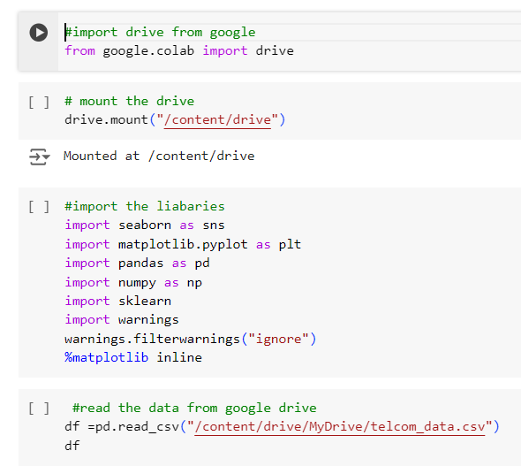
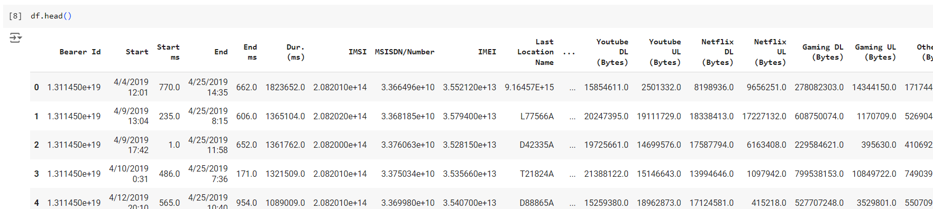
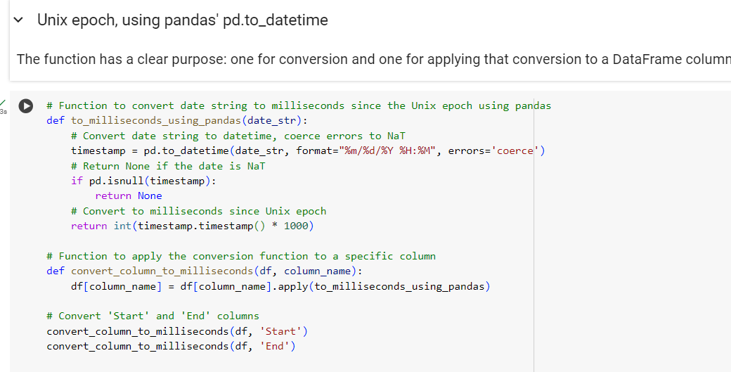
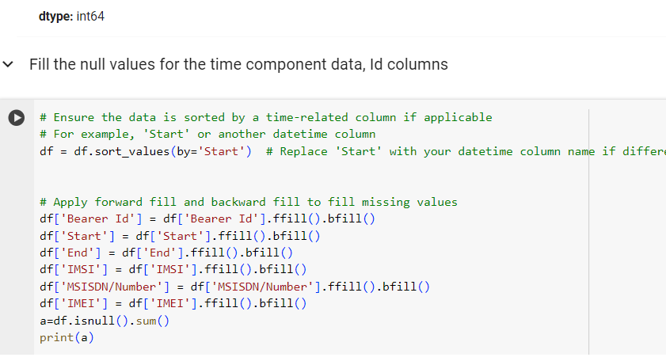
Data Cleaning and processing
Import the important libraries
seaborn and matplotlib are both libraries used for plotting the data frame
pandas and numpy are used for different wrangling methods mathematical method
sklearn for data analysis
Warnings to avoid unnecessary warnings while
running the codes
Access Data from one drive
To find null values
Get info on the data frame
Covert datatype (Unix epoch, using pandas' pd.to_datetime
Shape of data frame
Unique
Drop unwanted columns and row
Value counts for unique data
Fill Null values with mean, mode and fillna
Find the mean median to replace the null value

Slide 4
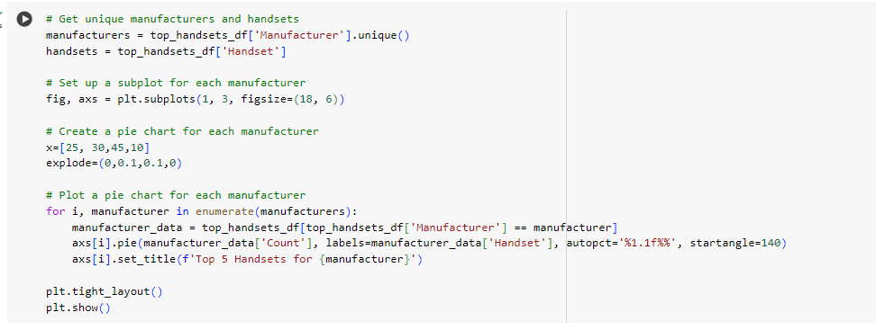
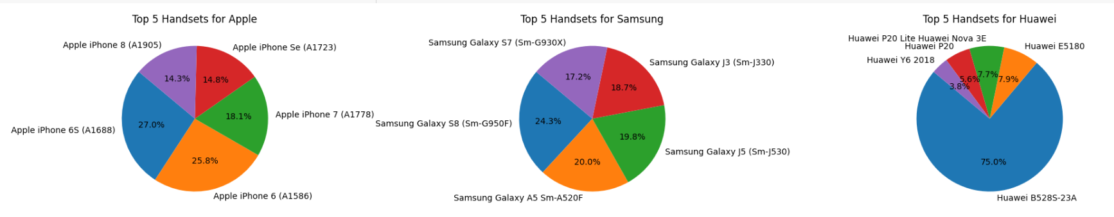
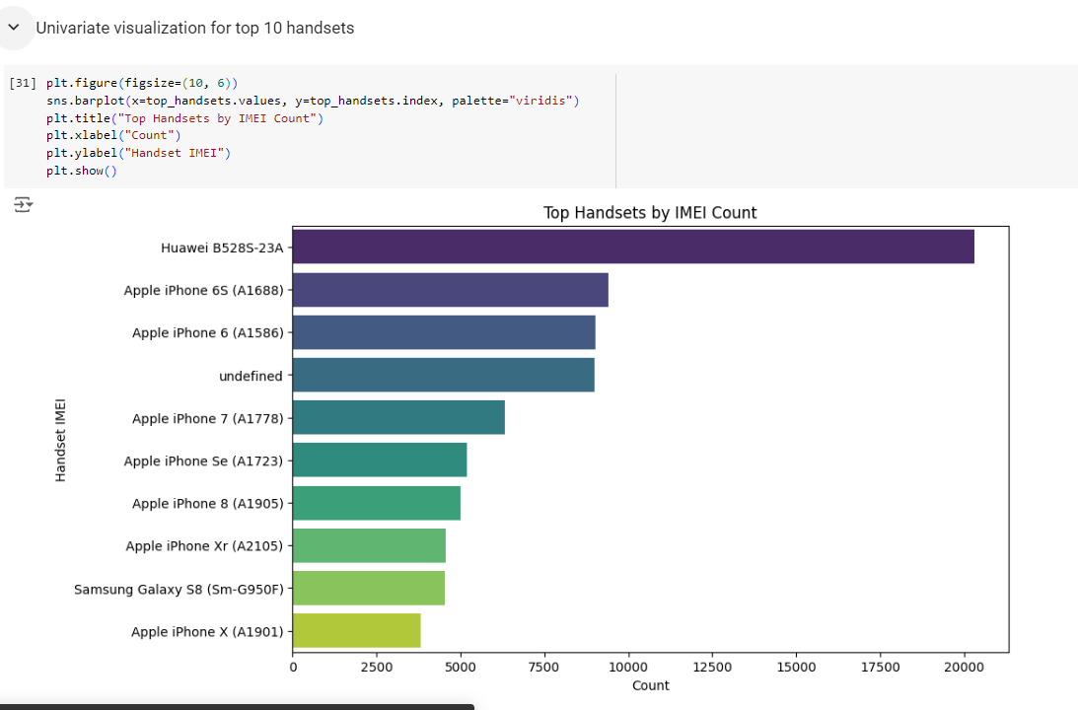
User Overview Analysis
Top 10 handsets used by the customers
top 10 handsets used by the customers.
the top 5 handsets per top 3 handset manufacturer
Feature Generation
Recommendations to Marketing Teams
1. Apple devices dominate the market. Create special promotions for Apple users, such as discounts on accessories or services.
2. Create promotions and offers for Samsung and Huawei users to boost their engagement and loyalty.
3. Sell popular handsets with accessories like cases and screen protectors to increase sales.
4. Send personalized offers based on handset usage For example, promote the latest models and features to younger users, while others might prioritize budget-friendly options
5. Ask for feedback from top handset users to understand their preferences and improve your marketing strategies.

Slide 5
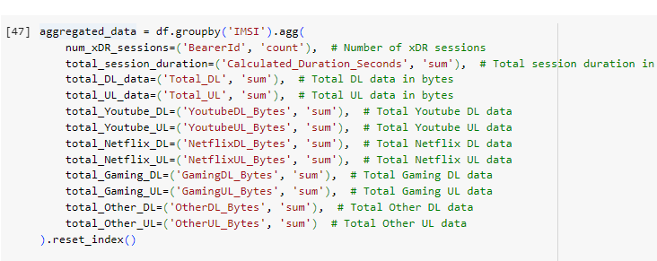
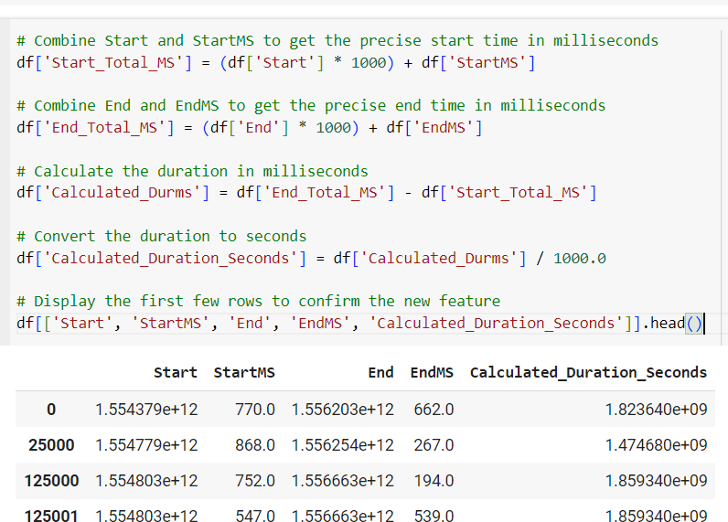
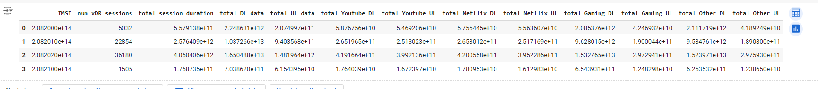
User Overview Analysis
Aggregate per user the following information in the column
number of xDR sessions
Session duration
the total download (DL) and upload (UL) data
the total data volume (in Bytes) during this session
for each application
Aggregate data for each application
Analysis
1. High Data Consumption: Users with long session durations and high data usage, especially in video streaming and gaming, are likely heavy consumers of network resources.
2. Application-Specific Trends: Applications like YouTube and Netflix are the most popular among users, indicating a strong preference for video content.
3. User Segmentation Opportunity: The data supports segmenting users into different categories (light, moderate, heavy) based on their session counts and data usage, enabling more personalized service offerings.

Slide 6
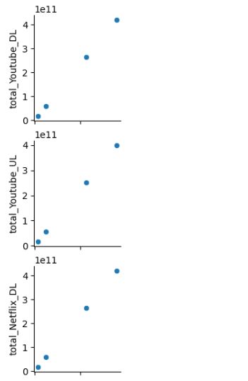
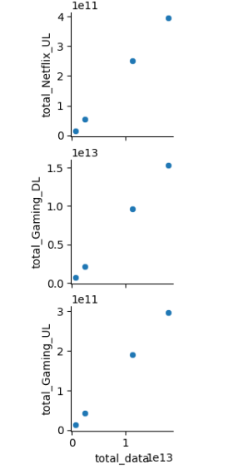
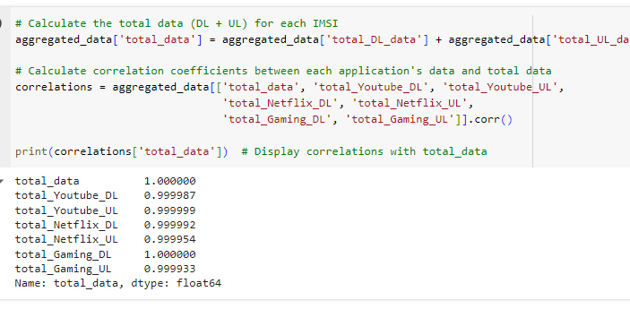
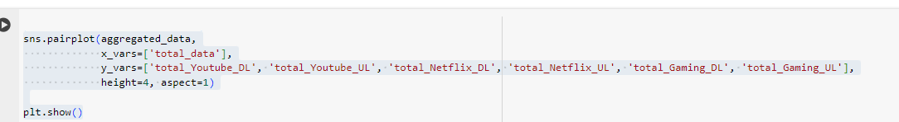
User Overview Analysis
Bivariate Analysis-Explore the relationship between each application and total_data
Key Observations:
Total data usage is strongly and equally influenced by the data usage of YouTube, Netflix, and Gaming.
Changes in any app's usage will directly impact total data, helping network operators manage bandwidth effectively.
A high correlation between app usage and total data means shifts in any app's usage can impact overall network traffic.

Slide 7
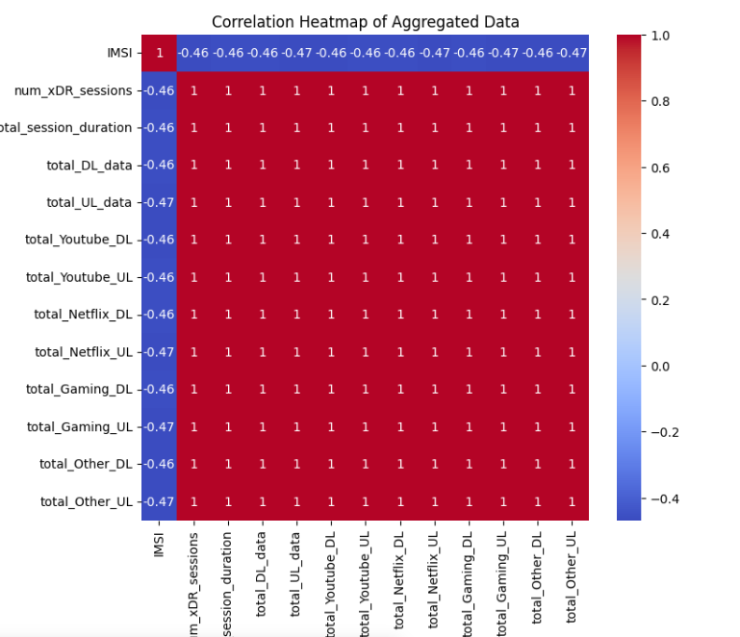
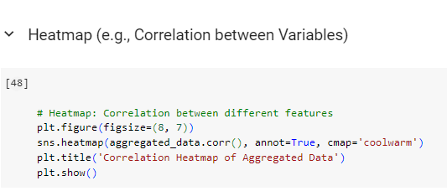
User Overview Analysis
Compute a correlation matrix
Key Observations:
If you see a strong positive correlation (e.g., 0.8) between total_DL_data and total_Youtube_DL, it indicates that users who download more data overall also tend to use more data on YouTube.
A strong negative correlation (e.g., -0.7) between total_Gaming_DL and total_Other_DL (hypothetically) would indicate that users who download a lot of gaming data tend to download less data from other services.

Slide 8
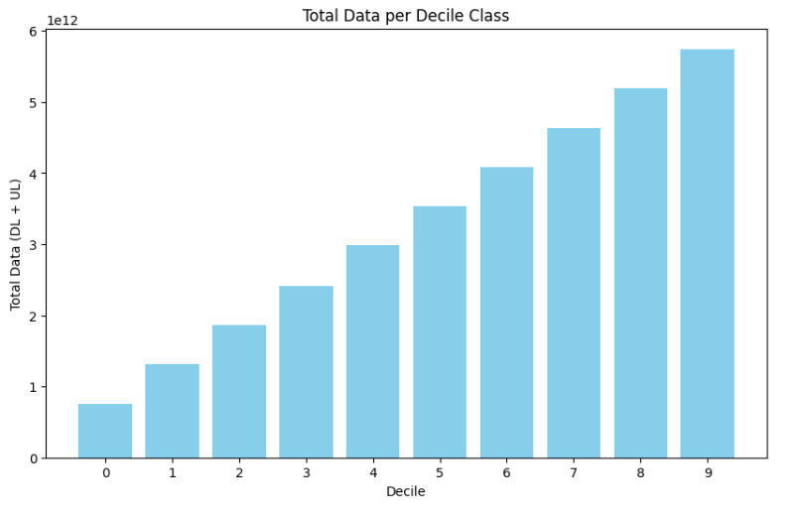
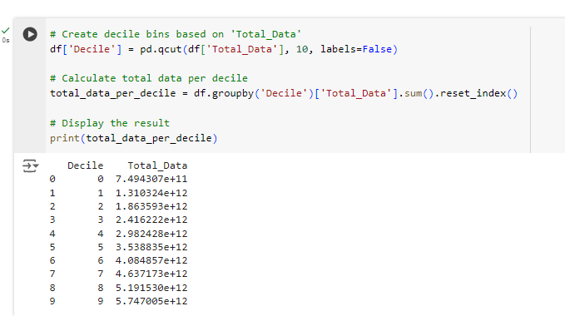
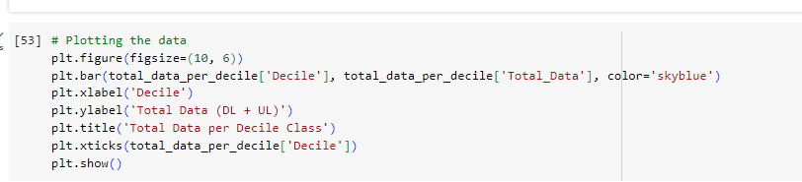
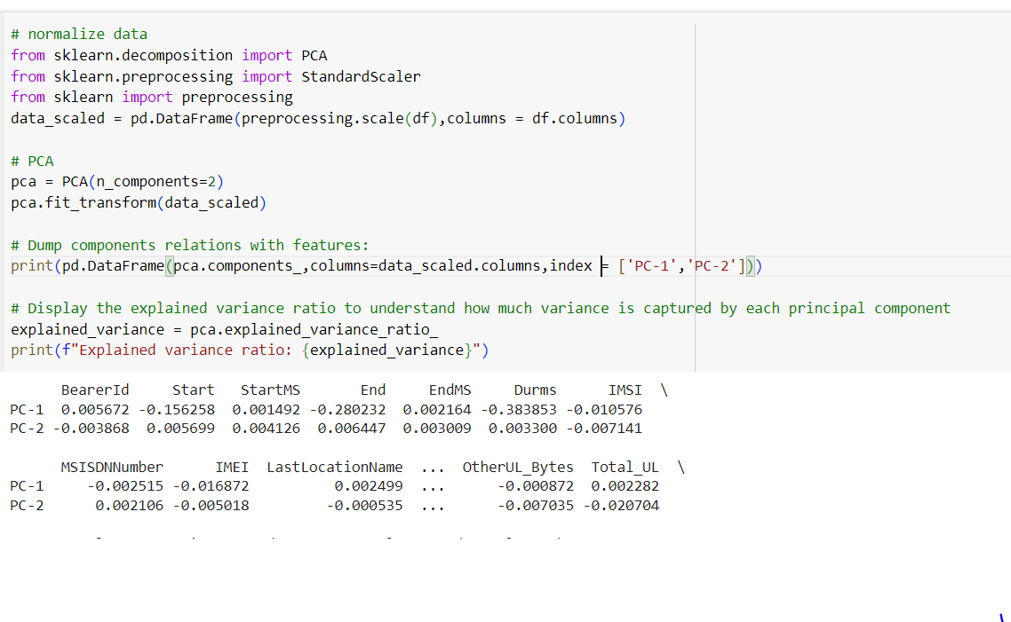
User Overview Analysis
Decile class is a method used to understand the distribution and usage patterns of data across different segments of the user base.
Dimensionality Reduction with
principal component analysis (PCA)

Slide 9
User Overview Analysis
Top 10 handsets used by the customers
top 10 handsets used by the customers.
the top 5 handsets per top 3 handset manufacturer
Feature Generation
Aggregate per user the following information in the column
number of xDR sessions
Session duration
the total download (DL) and upload (UL) data
the total data volume (in Bytes) during this session
for each application

Slide 10
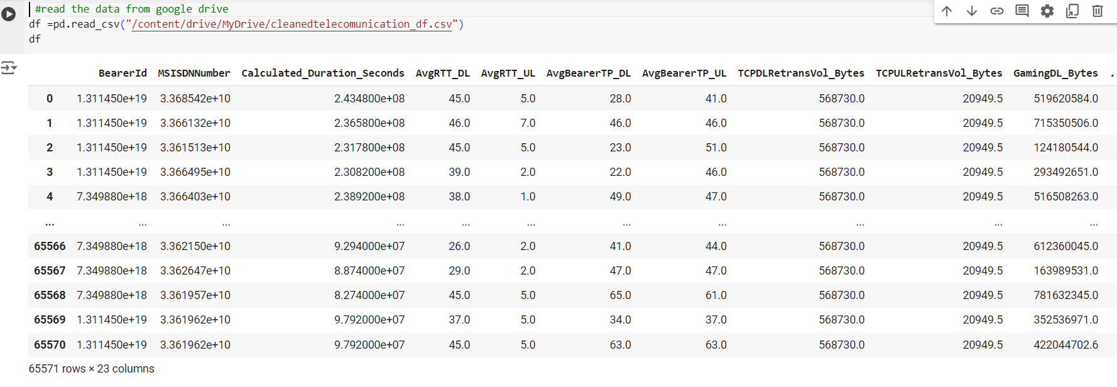
User Engagement Analysis
Read the clean data and access the most relevant features to analyze using the following engagement metrics:
● sessions frequency
● the duration of the session
● the session total traffic (download and upload (bytes))

Slide 11
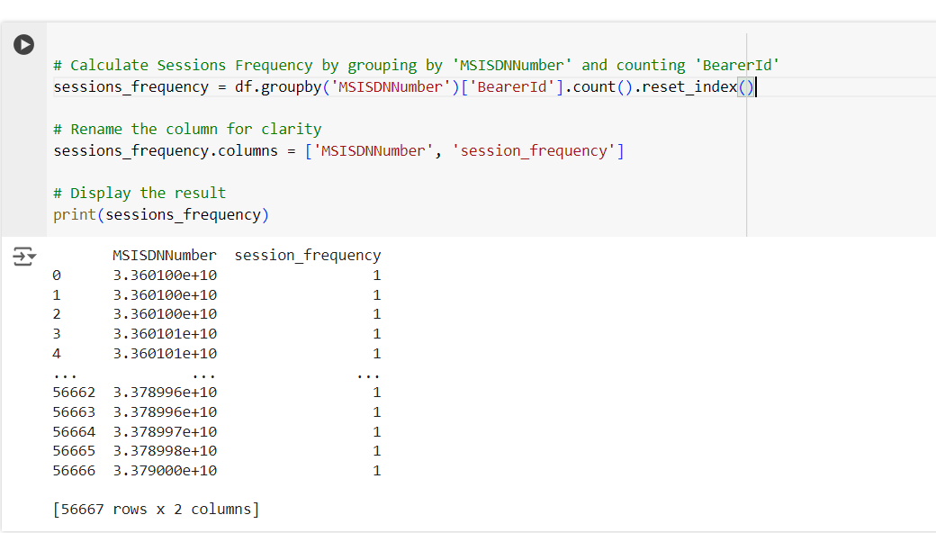
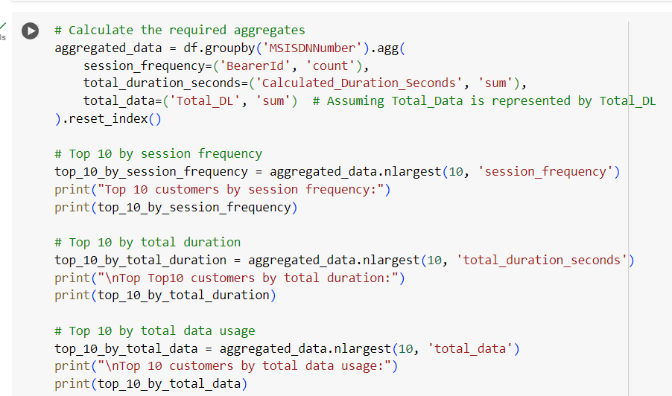
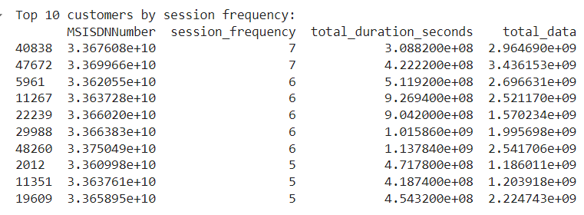
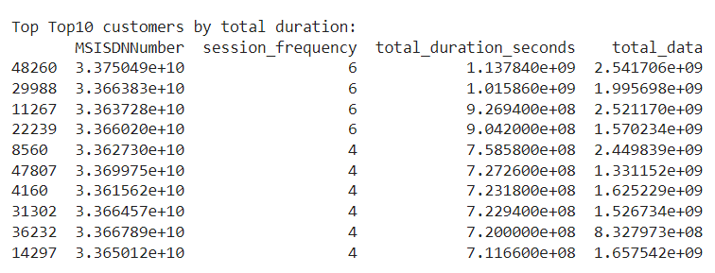
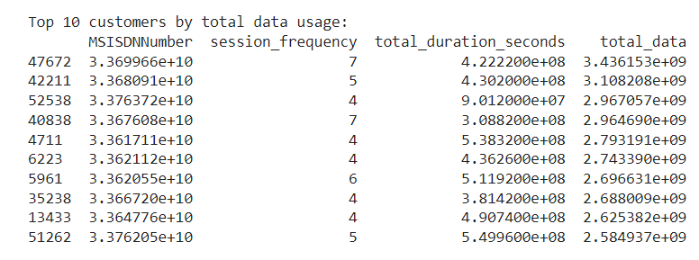
Calculate sessions frequency by grouping by 'msisdnnumber' and counting 'bearerid'
User Engagement Analysis
Find top 10 customers by each engagement metric

Slide 12
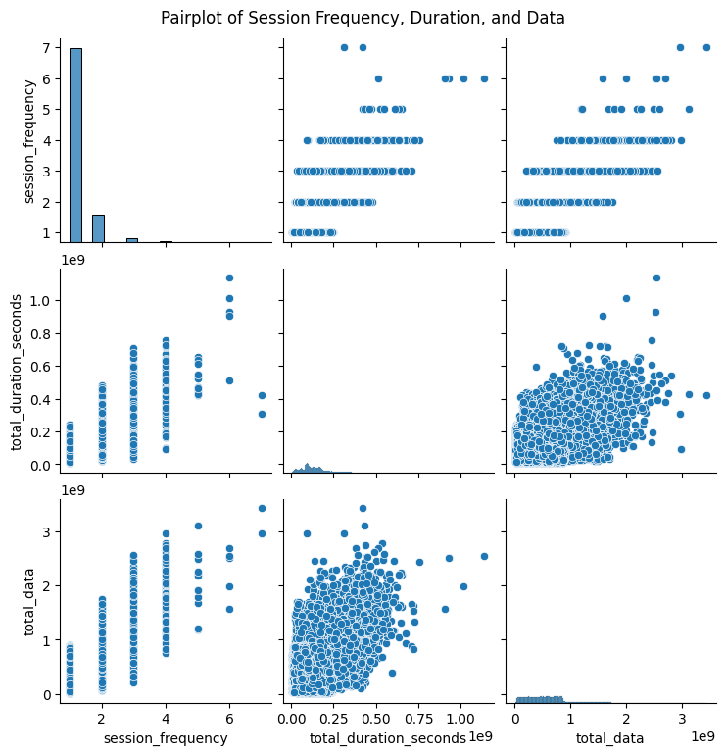
User Engagement Analysis
The pair chart
The pair chart confirms these relationships, showing clear linear trends between the variables, highlighting the predictive power of session frequency on both duration and data usage.

Slide 13
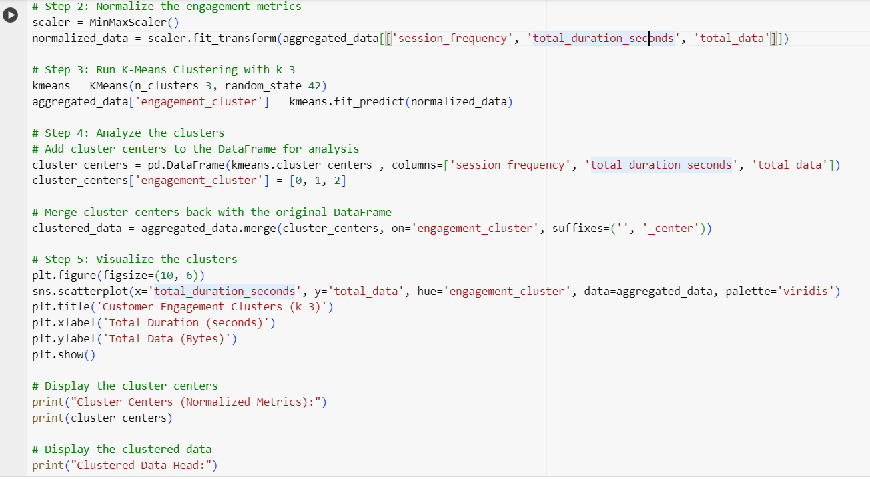
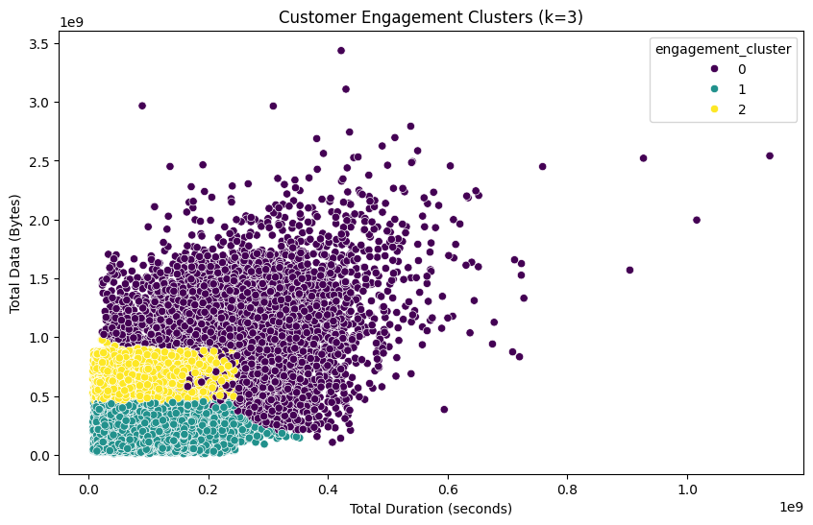
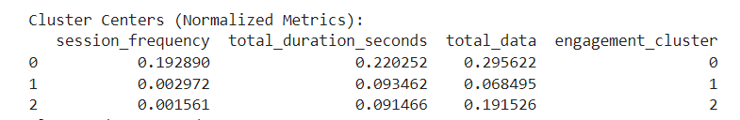
User Engagement Analysis
Normalize the Engagement Metrics and K-Means clustering algorithm to classify customers
Cluster 0 (Engagement Cluster 0): Represents the most varied group in terms of engagement. Includes customers who could be heavy users with longer session durations and higher data consumption.
Cluster 1 (Engagement Cluster 1): Represents customers with low engagement. They have short session durations and consume relatively little data.
Cluster 2 (Engagement Cluster 2): Likely represents customers with moderate engagement. They consume more data than Cluster 1 but have shorter durations, possibly indicating efficient or high-speed usage.

Slide 14
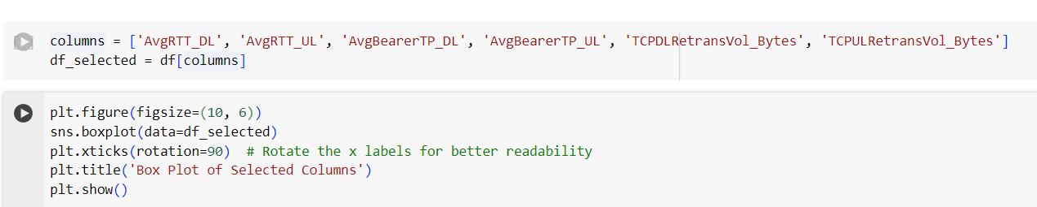
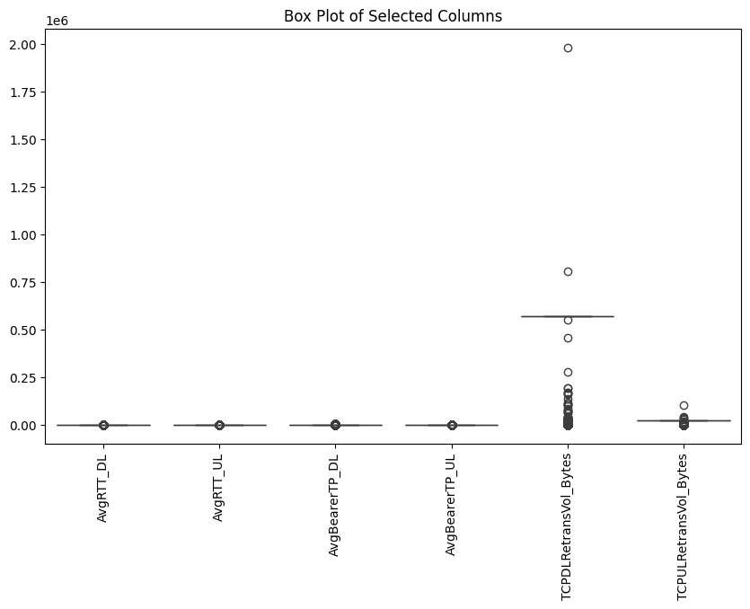
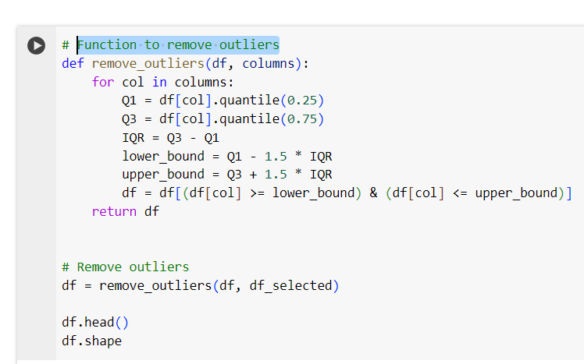
Experience Analytics
The health of a connection on a local network or the larger Internet, and is commonly utilized by network administrators to diagnose the speed and reliability of network connections with the help of TCP and RTT
Create the Box Plot to find the outliers
Function to remove outliers

Slide 15
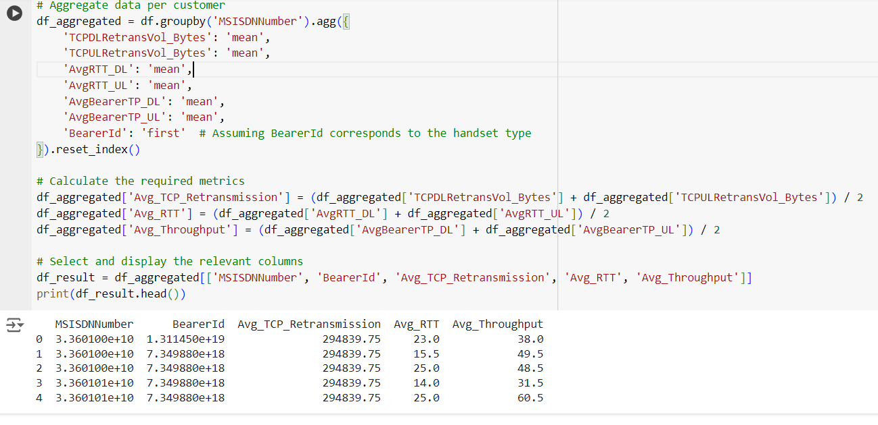
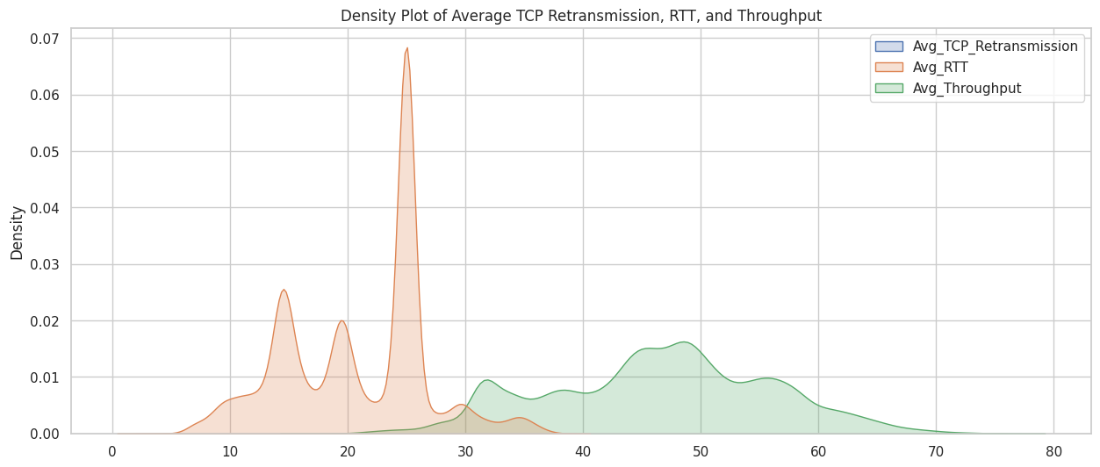
Experience Analytics
Aggregate, per customer,
● Average TCP retransmission ● Average RTT ● Handset type ● Average throughput
RTT values (14.0-25.0 ms) suggest varying connection responsiveness, while throughput (31.5-60.5 Mbps) varies across sessions,
But consistent high TCP retransmission (294,839.75 bytes) indicates potential packet loss or network congestion.
Avg_TCP_Retransmission: Highly clustered, indicating little variation; may suggest consistent performance or data issues.
Avg_RTT: Varied with specific peaks, reflecting diverse network conditions experienced by users.
Avg_Throughput: Evenly distributed with some concentration; shows a broad range of user experiences.
Pairwise Relationships: No clear correlations between metrics, suggesting they may operate independently.

Slide 16
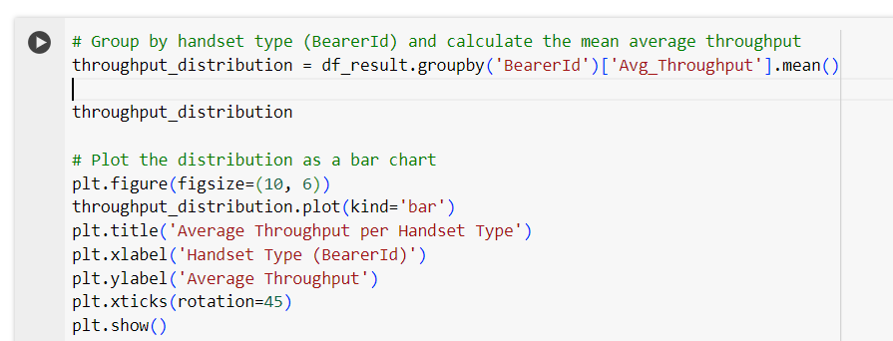
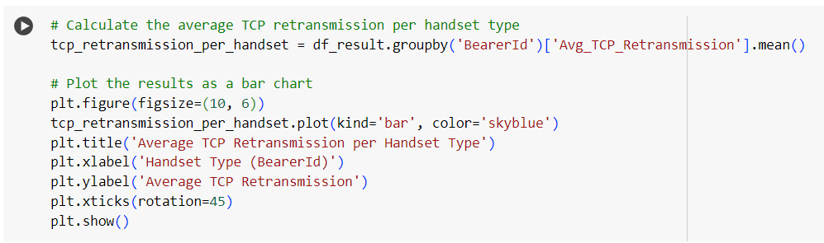
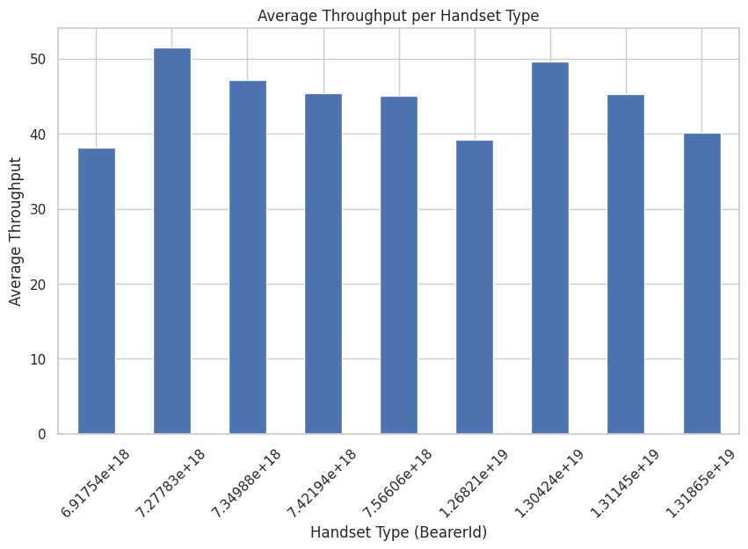
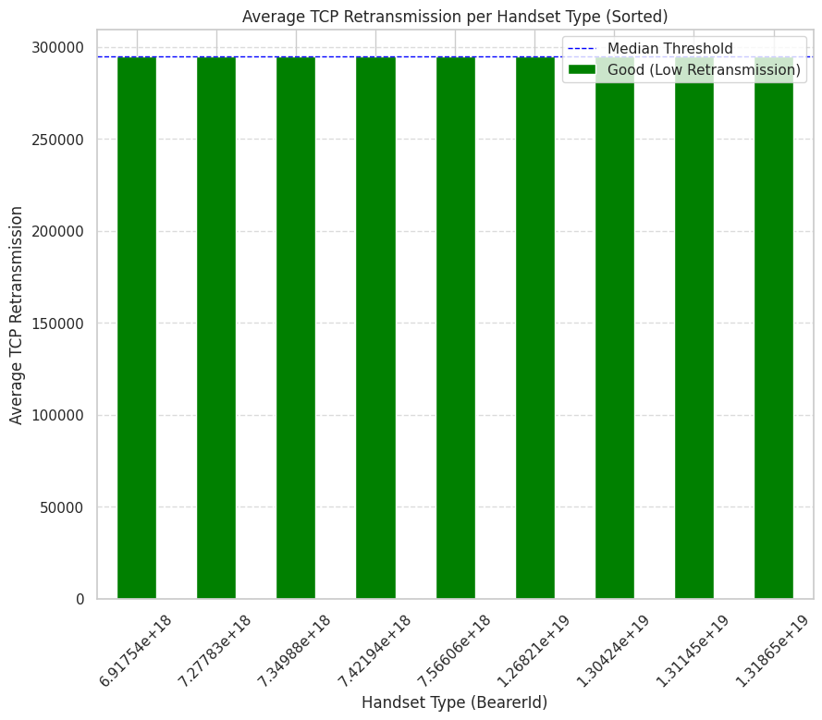
Experience Analytics
Throughput in networking refers to the rate at which data is successfully transmitted over a network. It's typically measured in bits per second (bps), kilobits per second (kbps), or megabits per second (Mbps).
TCP (Transmission Control Protocol) is a core protocol of the Internet Protocol Suite that ensures reliable data transmission between a sender and receiver.
A certain handset type consistently shows low throughput, operators might focus on improving network conditions or suggesting handset upgrades to users.
Potential Network Stability:
The consistent retransmission rates across handset types indicate a stable network environment.

Slide 17
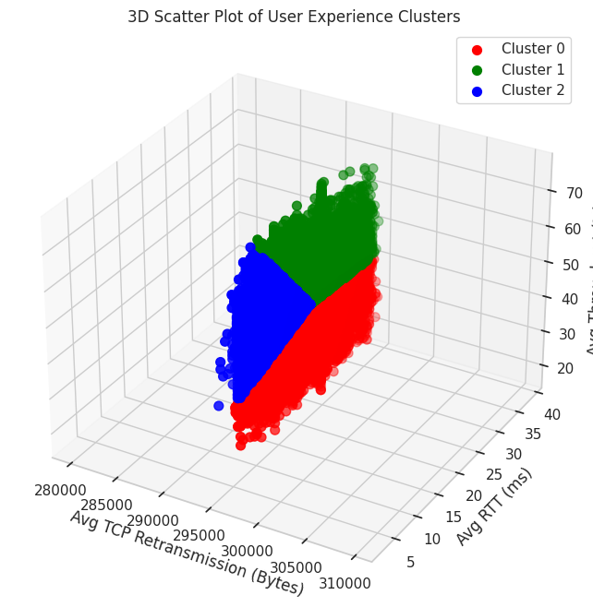
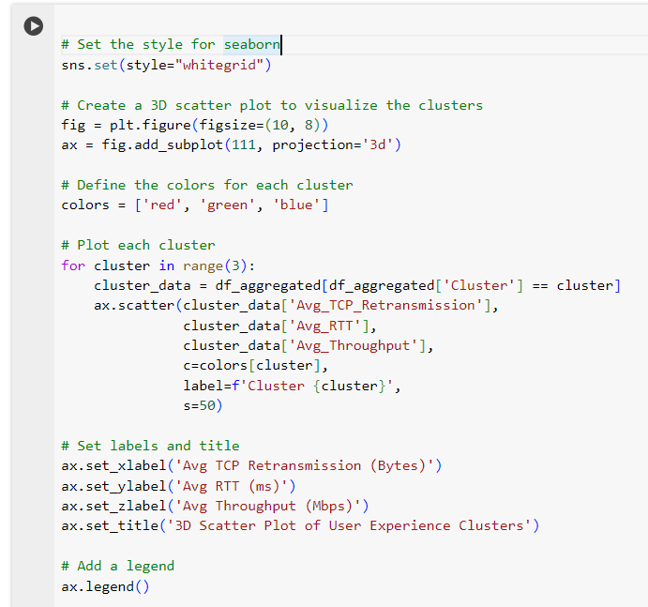
Experience Analytics
Cluster 0 represents users with a more average network experience with moderate latency and lower data speeds.
Cluster 1consists of users with higher latency but better throughput, indicating that they can handle more data despite longer wait times.
Cluster 2 includes users who benefit from low latency and decent throughput, leading to a good overall experience.

Slide 18
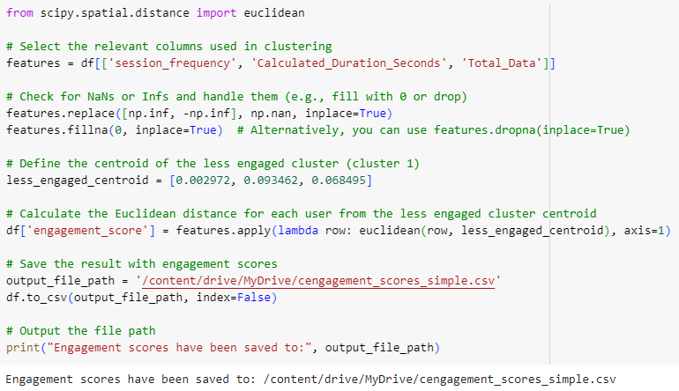
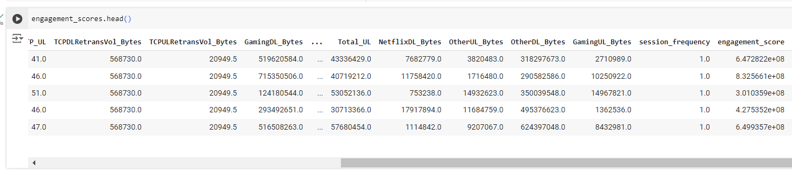
Satisfaction Analysis
The satisfaction of a user is dependent on user engagement and experience,
The engagement score as the Euclidean distance between the user data point & the less engaged cluster

Slide 19
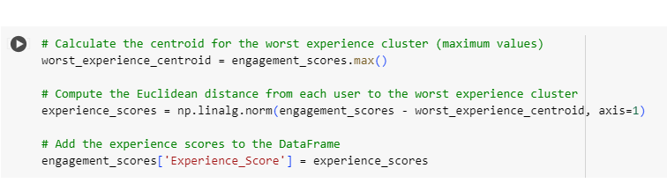
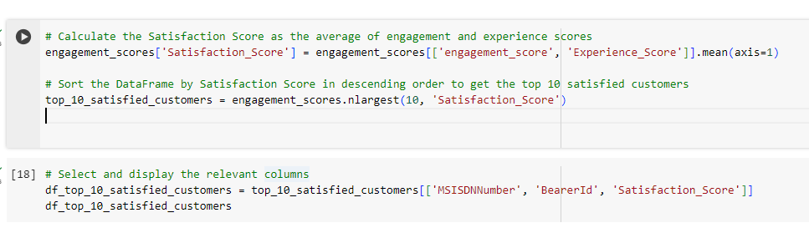
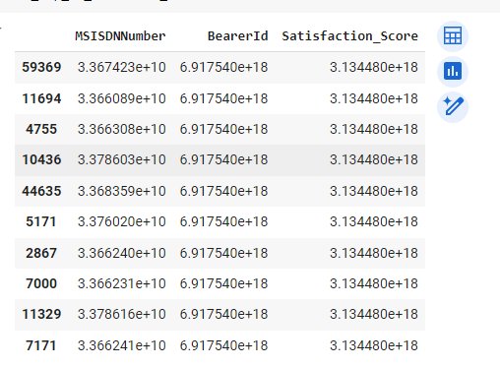
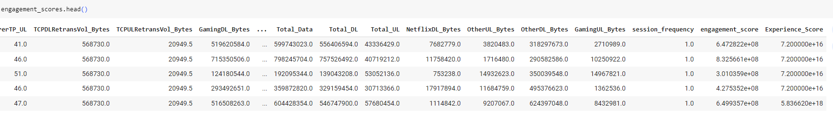
Satisfaction Analysis
The experience score as the Euclidean distance between the user data point & the worst experience cluster.
The satisfaction score & report the top 10 satisfied customer

Slide 20
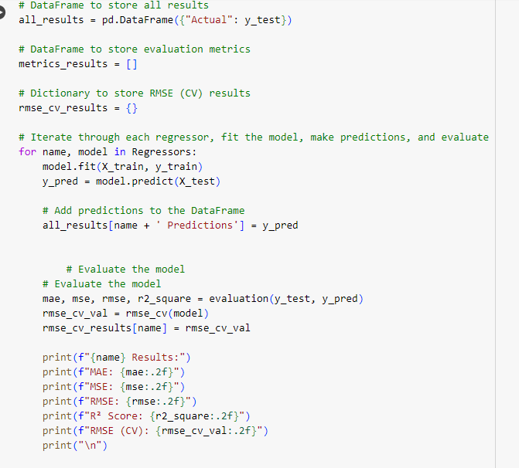
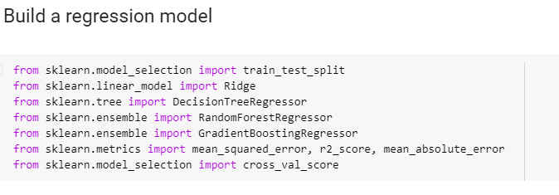
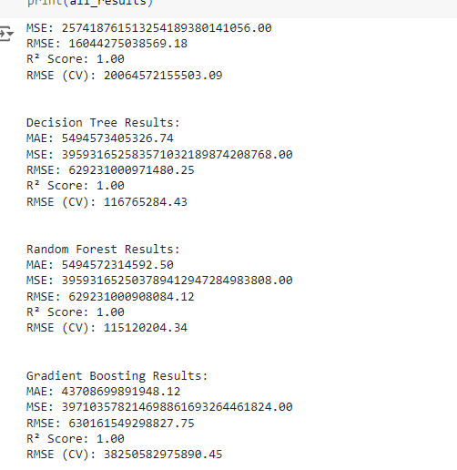
Satisfaction Analysis
Build a regression model
All Regression model result
Given the results, Random Forest seems to be the best model among the four options. Although all models show signs of overfitting with perfect R² scores and high error metrics, Random Forest has the lowest RMSE (CV), suggesting it generalizes slightly better on unseen data compared to the other models.

Slide 21



Satisfaction Analysis
k-means (k=2) on the engagement & the experience score
Cluster 1 (Purple): If these users have lower engagement and experience scores, they might be at risk of churn or may require targeted interventions to improve their experience and increase their engagement.
Cluster 2 (Yellow): These users are likely satisfied and engaged, representing a more loyal user base. Efforts to maintain or further enhance their experience could help retain this segment.

Slide 22
THANK YOU
User Engagement Analysis report , Experience Analytics report and Satisfaction Analysis show less engaged user experience with the service and highest engaged user experience with the service .
TellCo provides the good service with a good network. Concerning lower engagement and experience, who might require more attention to improve their satisfaction? So TellCo is well worth buying.

